Slide 1
Big Data Midterm Project
Finding Trends in the Voter Support for Different Candidates in the 2016 US Presidential Primaries

Slide 2
Questions
Counties with greater Bernie Sanders/Hillary Clinton support correlate to which Republican candidate's support?
What demographics are associated with a greater vote share for a particular candidate - income, unemployment rate, the percentage of white people, or population density?

Slide 3
How?
Primary data from FiveThirtyEight
2015 US Census estimates of median income, unemployment, and percentage white people of the total population in each county
2010 US Census survey results of population density

Slide 4
Important Considerations
Missing Counties
Party Demographics vs County Demographics

Slide 5
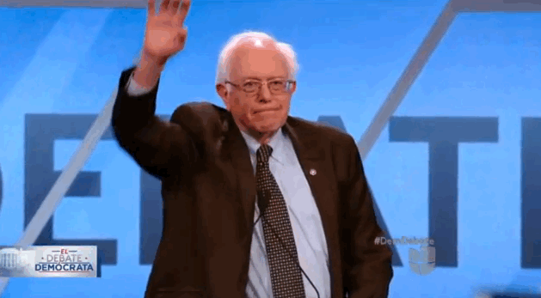
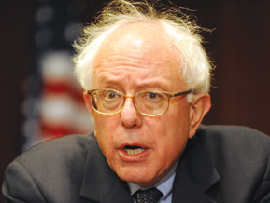
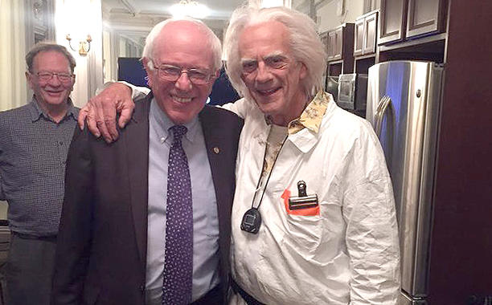
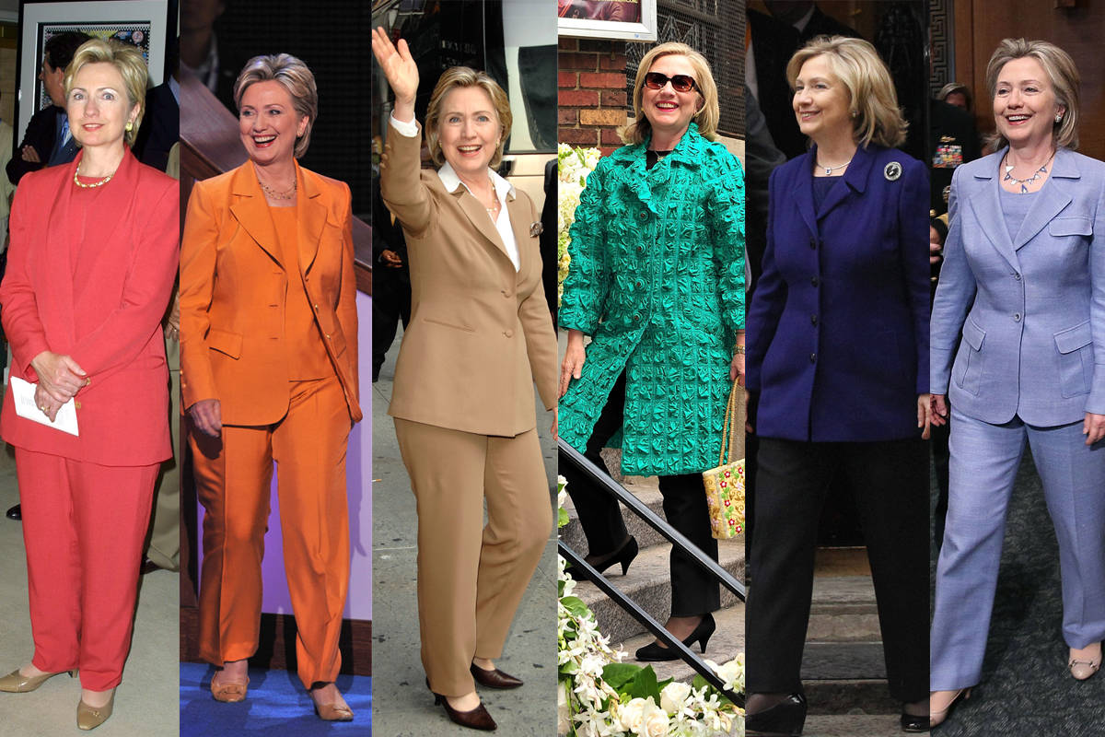
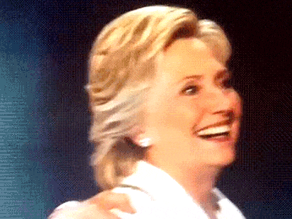
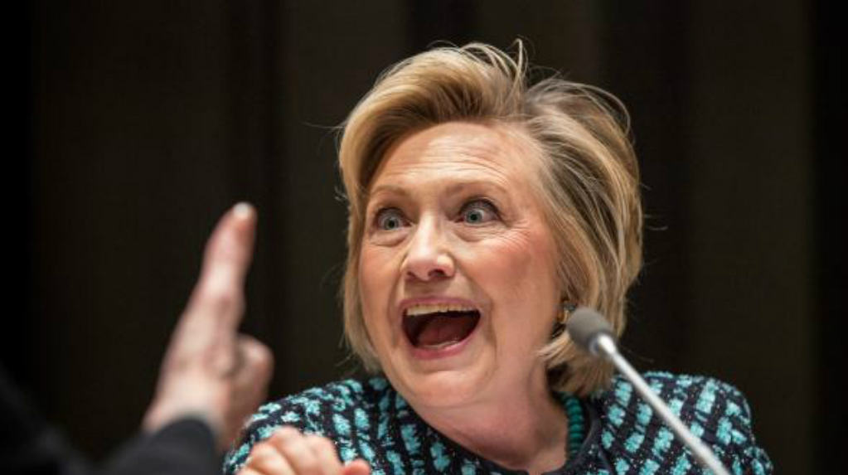
BERNIE SANDERS and HILLARY CLINTON

Slide 6
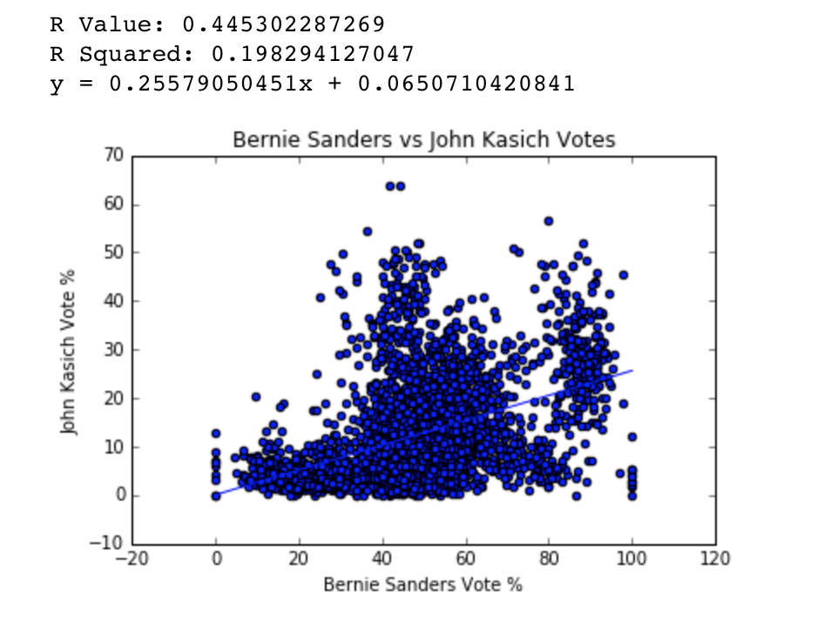
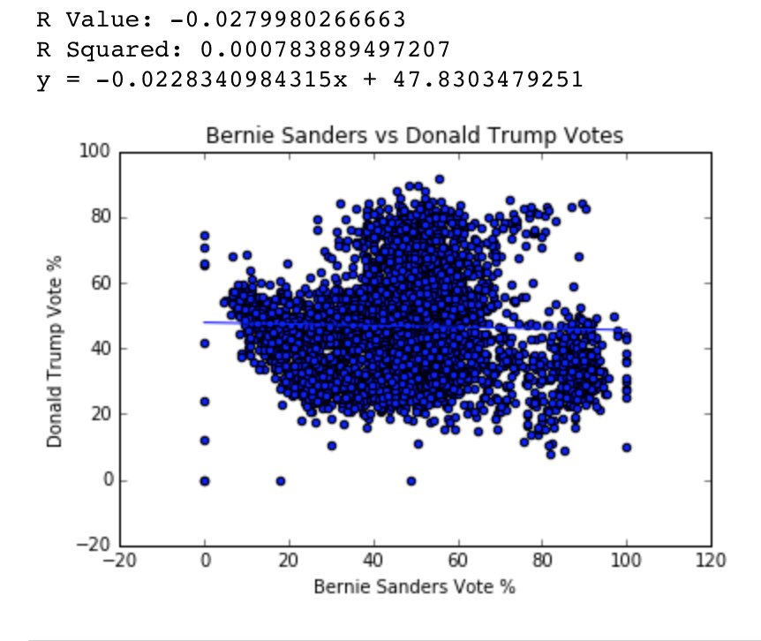
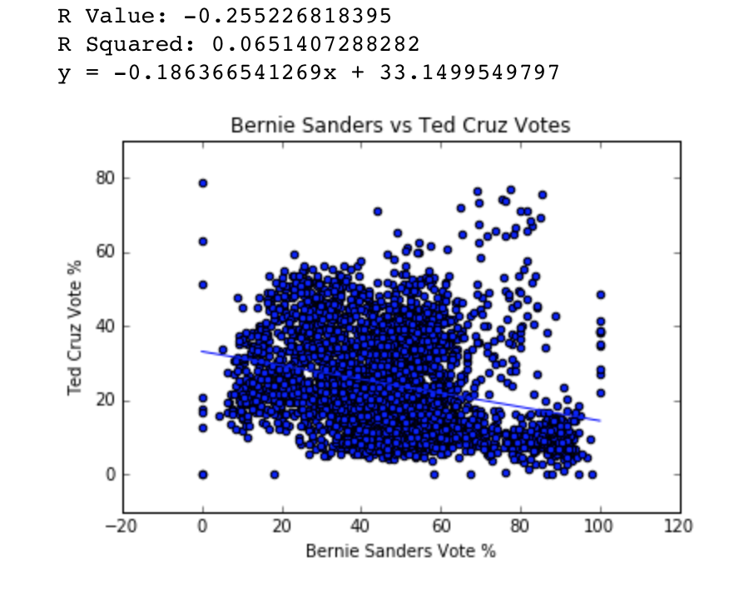
Bernie Sanders/Hillary Clinton
Counties that had more democrats voting for Bernie/Clinton did not tend to have more republicans voting for Donald Trump
Counties that had more democrats voting for Bernie tended to have less republicans voting for Ted Cruz/ more Clinton -> more Cruz
Counties that had more democrats voting for Bernie tended to have more republicans voting for John Kasich/ more Clinton -> less Kasich

Slide 7
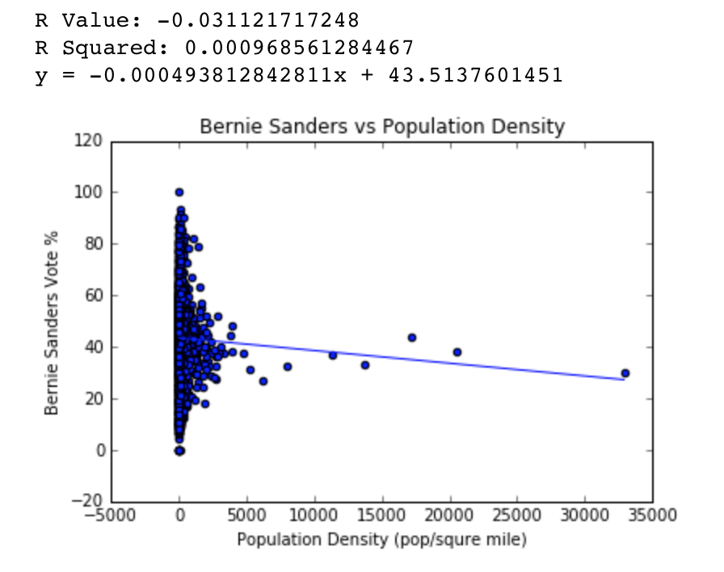
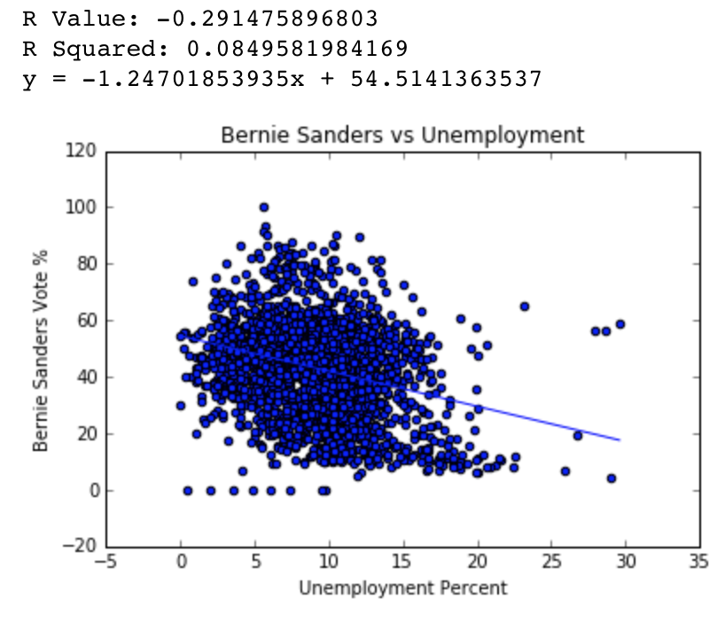
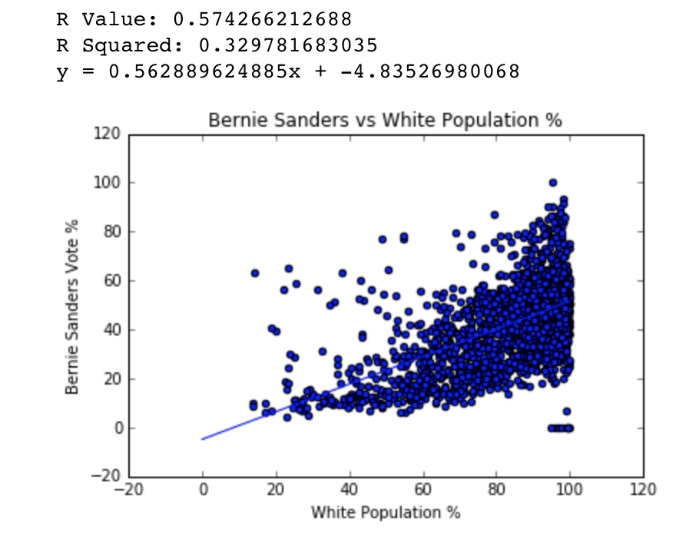
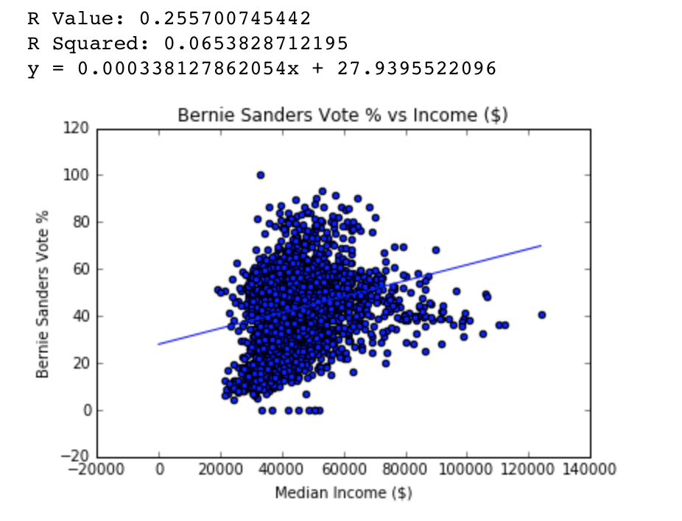
Bernie Sanders/Hillary Clinton
Counties that had a greater median income tended to have more Democrats voting for Bernie
Counties that had a higher unemployment rate tended to have more Democrats voting for Hillary
Counties that had a greater proportion of white people tended to have more Democrats voting for Bernie
There was a very weak, negative correlation between county population density and Bernie votes (and vise-versa)

Slide 8
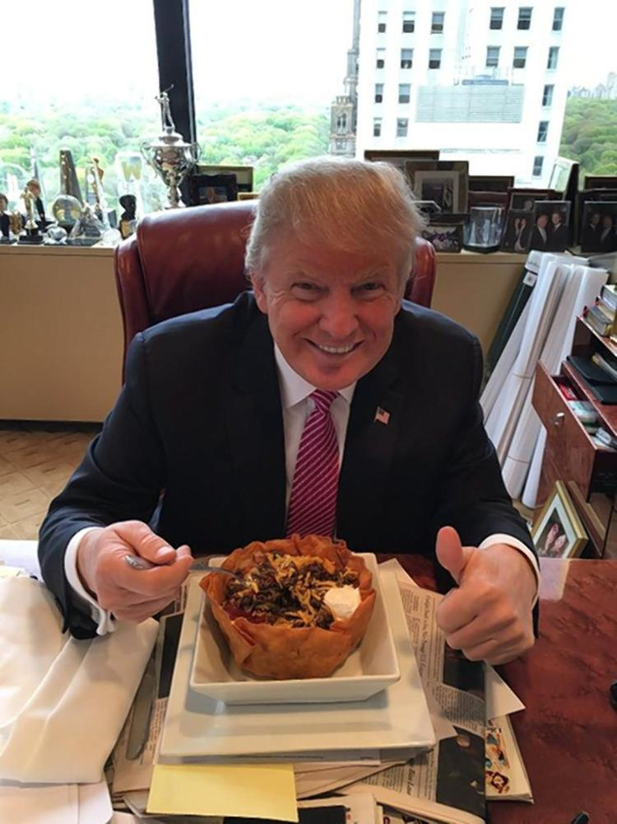
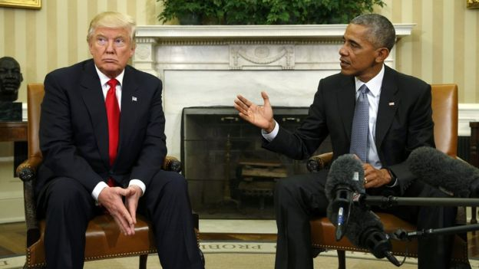
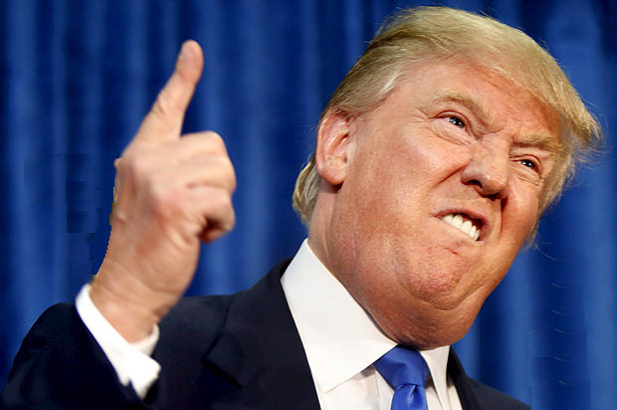
Donald Trump

Slide 9
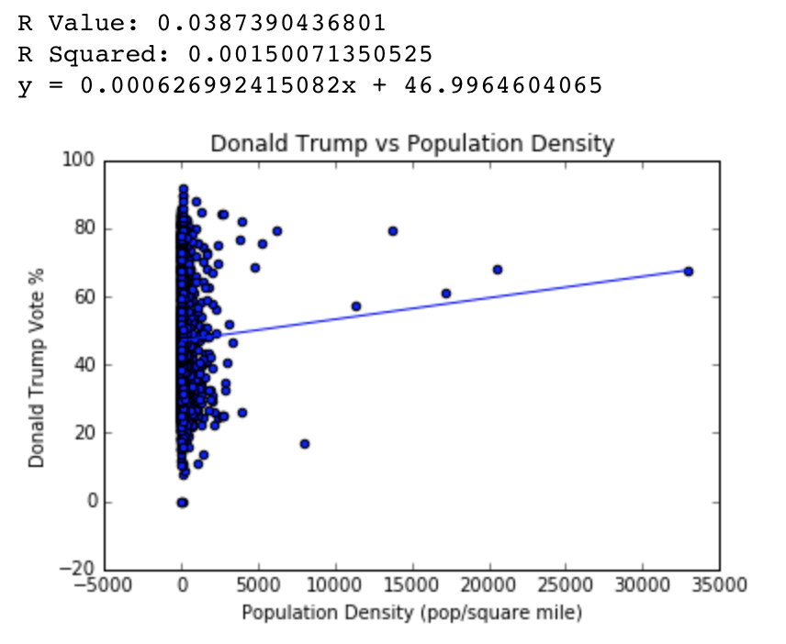
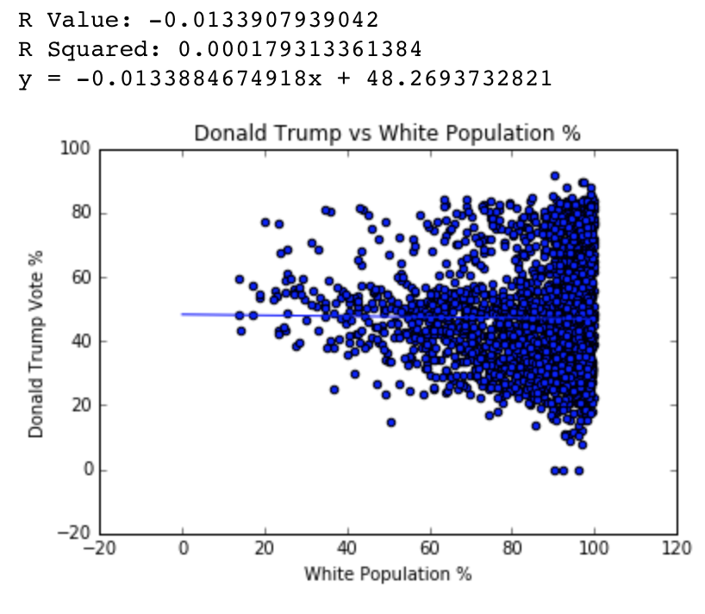
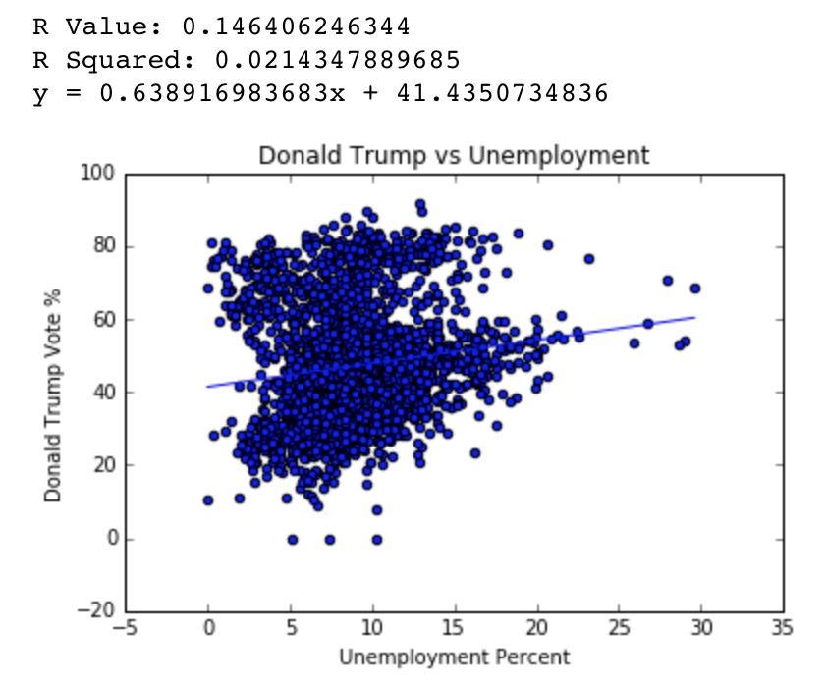
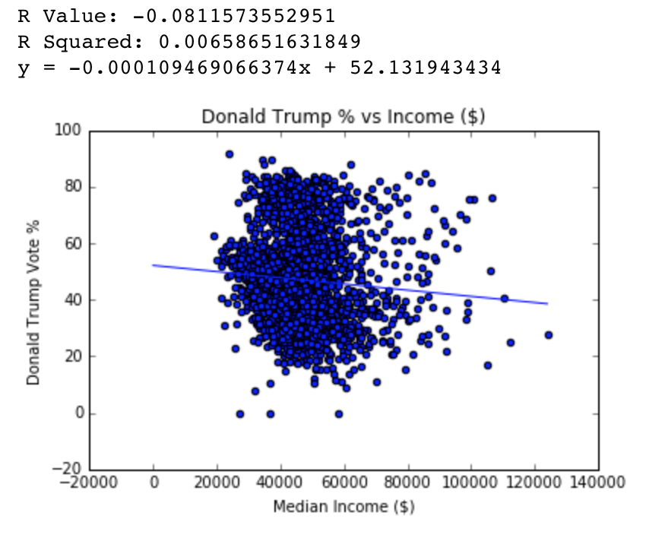
Donald Trump
Counties that had a lower median income tended to have more Republicans voting for Donald Trump
Counties that had a higher unemployment rate tended to have more Republicans voting for Donald Trump
Counties that had a greater or lower proportion of white people were no more likely to have Republicans vote for another candidate over Trump
There was a very weak, positive correlation between county population density and Donald Trump votes

Slide 10
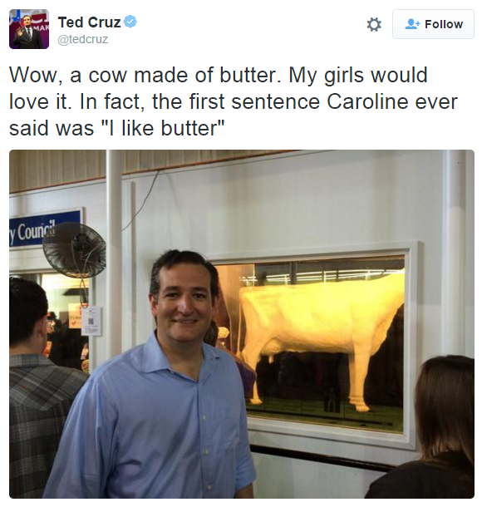
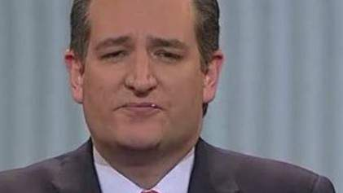
Ted Cruz

Slide 11
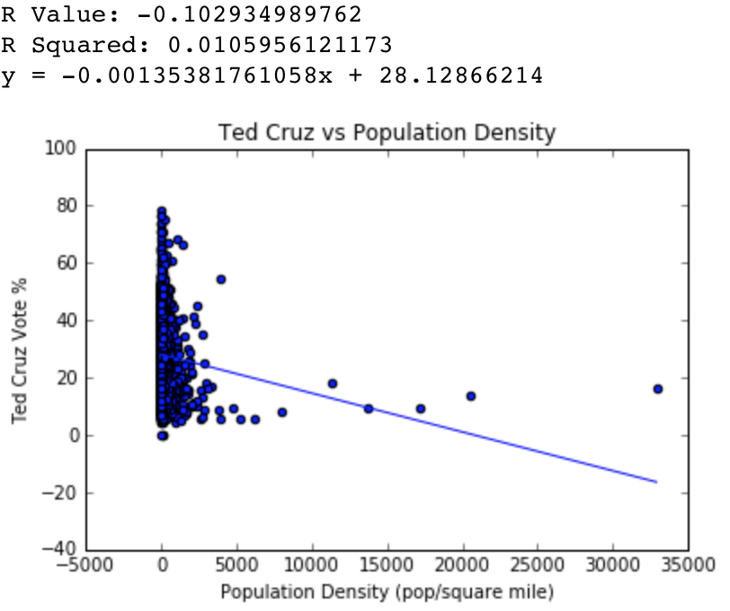
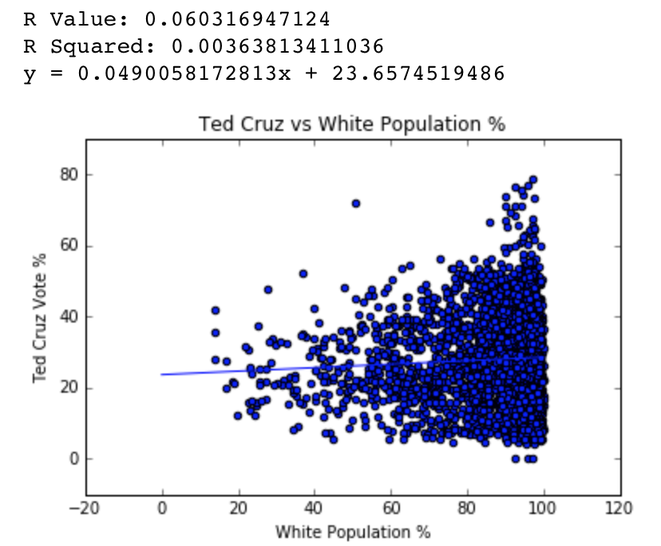
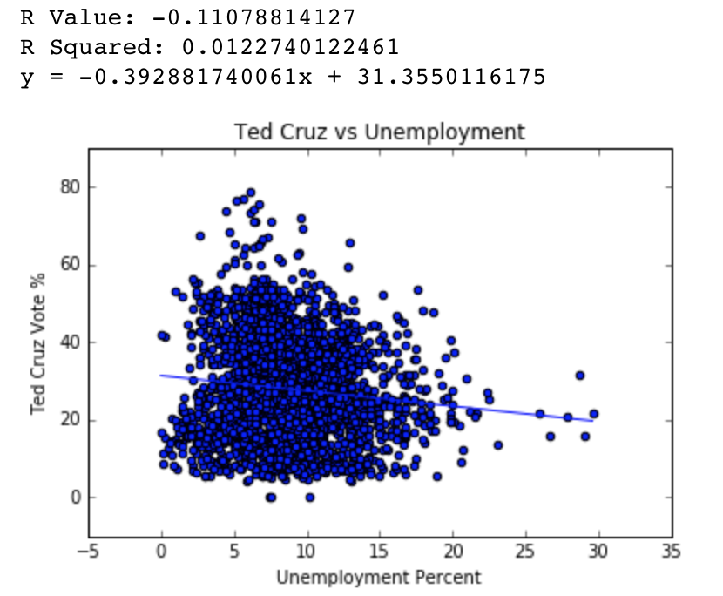
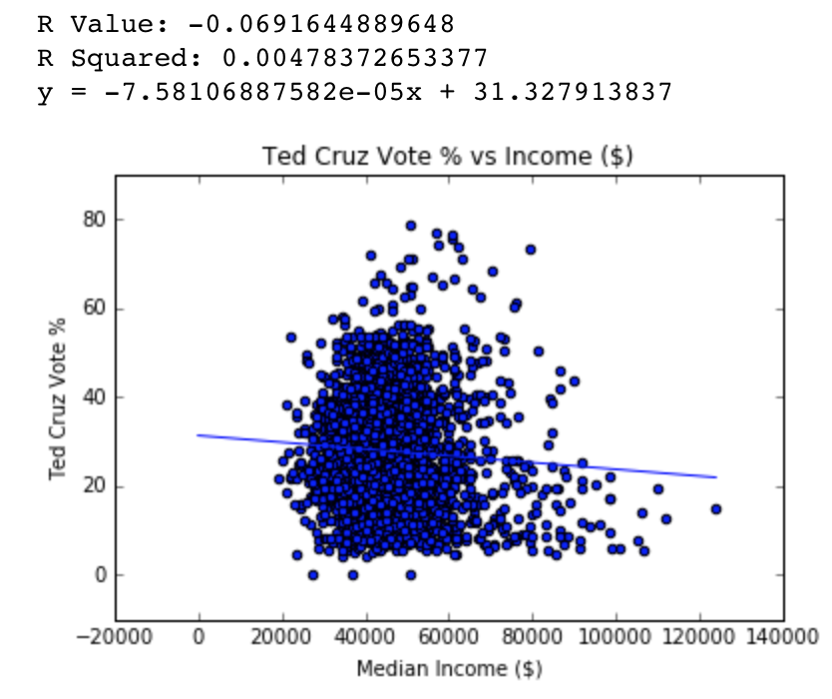
Ted Cruz
Counties that had a lower median income tended to have slightly more Republicans voting for Ted Cruz
Counties that had a lower unemployment rate tended to have more Republicans voting for Ted Cruz
Counties that had a greater proportion of white people were slightly more likely to have Republicans voting for Ted Cruz
Counties that had a lower population density were more likely to have Republicans voting for Ted Cruz

Slide 12
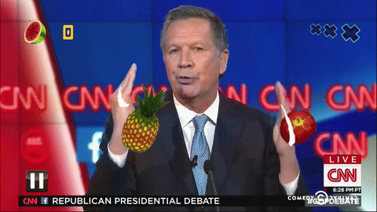
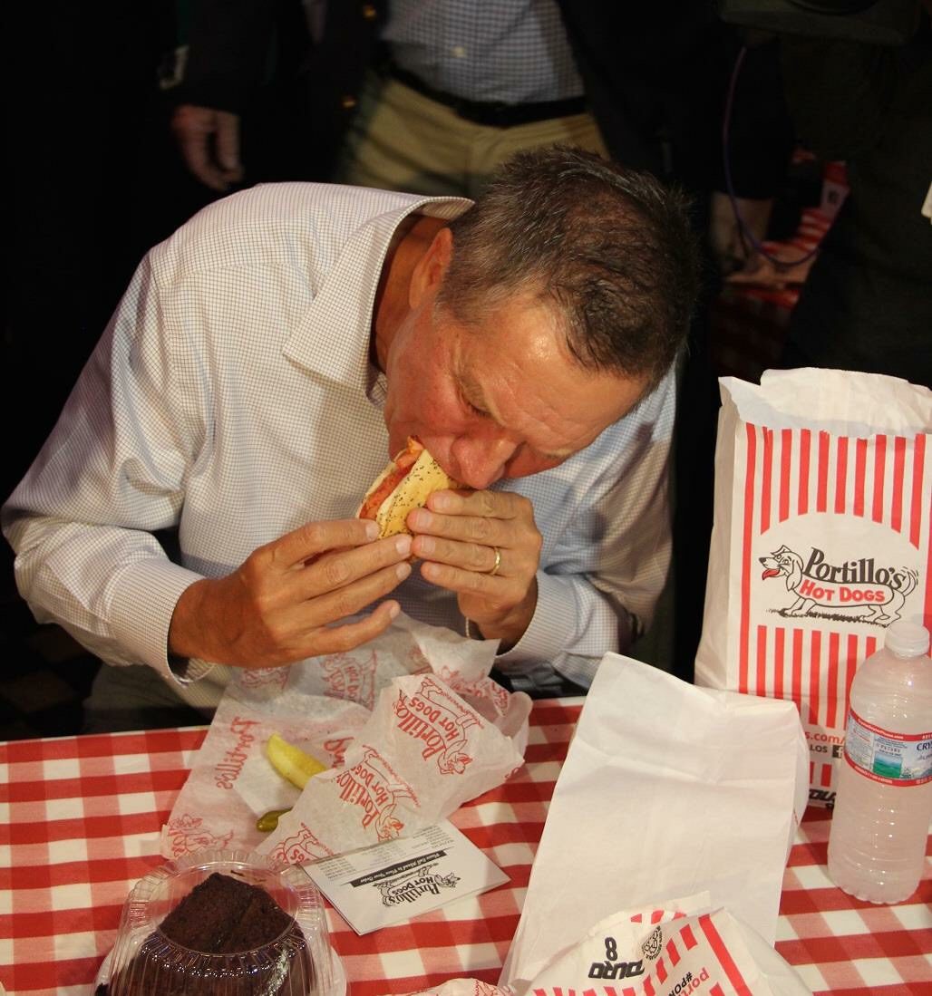
John Kasich

Slide 13
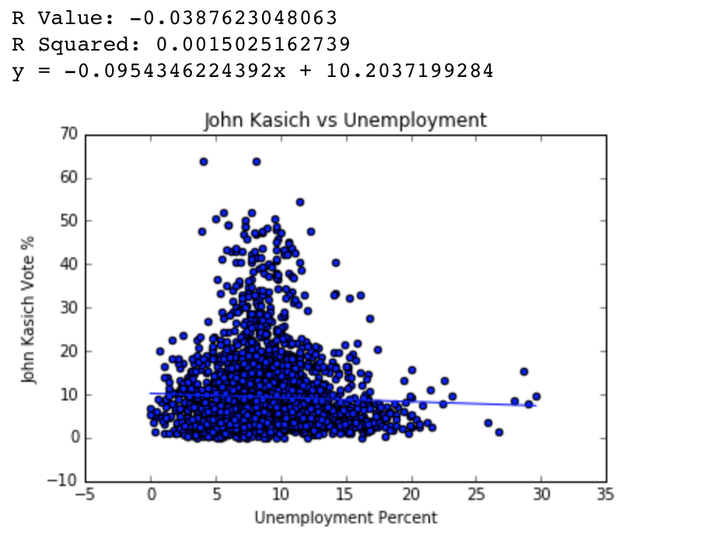
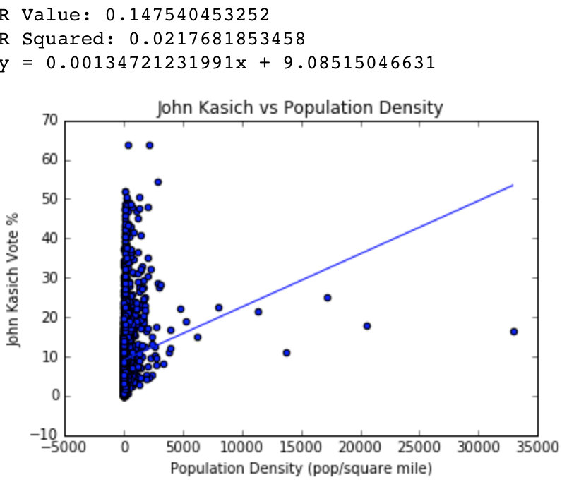
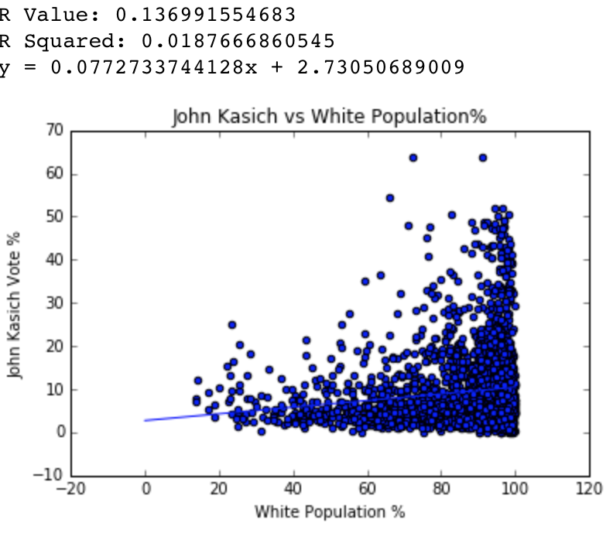
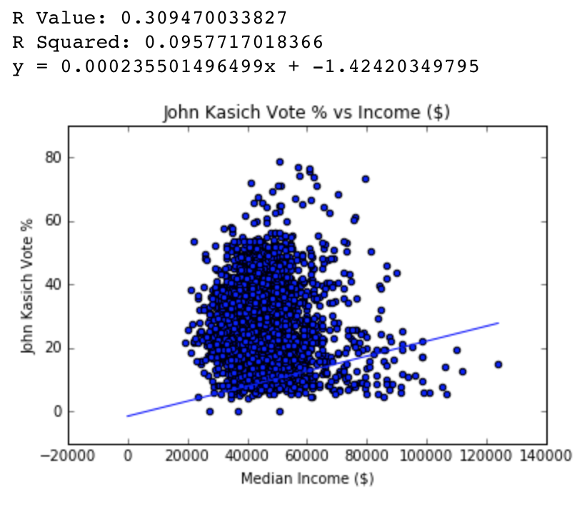
John Kasich
Counties that had a higher median income tended to have more Republicans voting for John Kasich
Counties that had a lower unemployment rate tended to have very very slightly more Republicans voting for John Kasich
Counties that had a greater proportion of white people were more likely to have Republicans voting for John Kasich
Counties that had a higher population density were more likely to have more Republicans voting for John Kasich

Slide 14
Interesting Observations
Candidates that had correlations between vote shares did not always have the same demographic correlations
Both Bernie Sanders and John Kasich were correlated to a higher median income and greater proportion of white people. However counties with greater support for John Kasich were also correlated with a slightly higher unemployment and a higher population density.
There were stronger divisions based on race, income, and unemployment in the Democrat party than the Republican party

